Slide 1
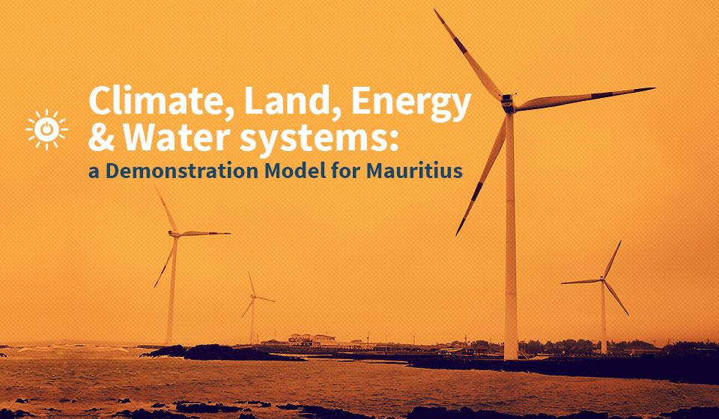

Slide 2
CLEWS Country Module
1. The food-energy-water nexus and sustainable development
2. The need for integrated planning: case studies
3. The CLEWS modelling approach
4. CLEWS case studies
5. Hands-on exercises with CLEWS

Slide 3
3. The CLEWS modelling approach

Slide 4
Adding climate allows assessment of policy robustness to climate change
CLEWS
quantifying the FEW-NEXUS
Energy model
Energy for water processing and treatment
Energy for water pumping
Energy for desalination
Water available for hydropower
Water for power plant cooling
Water for (bio-) fuel processing
Energy for fertilizer production
Energy required for field preparation and harvest
Biomass for biofuel production and other energy uses
Greenhouse gas emissions
Quantifies the
food-energy-water nexus
Climate
Water model
Land use model
Precipitation temperature
Water for biofuel crops (rain-fed and irrigated)
Water needs for food, feed and fibre crops (rain-fed and irrigated)
Notes:
The diagram shows the main components of CLEWS analysis and modelling.
For a non-technical audience, the link between emissions and climate needs to be conveyed in a subtle manner.
CLEWS provides output indicators relevant to climate change such as emissions and changes in area covered by forests, among others. But these outputs are not run through a climate change model.
CLEWS uses expected changes in relevant factors for water, land-use and energy systems; examples include precipitation and temperature.

Slide 5
Greenhouse gas emissions and the food-energy-water nexus
Global emissions by sector
Agriculture, forestry and other land use
23.1%
Electricity and
heat
25.3%
Residential
6.5%
Other energy
9.9%
Transport
14.2%
Waste
Industry
2.9%
18.1%
Notes:
The food-energy-water nexus is important in terms of emissions. There are several ways to account for anthropogenic emissions.

Slide 6
Greenhouse gas emissions from electricity generation
Notes:
Electricity generation and other energy uses are major contributors to carbon dioxide emissions.

Slide 7
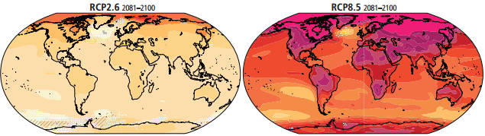
Climate change and the food-energy-water nexus
Climate change is often said to “manifest through water”
More frequent extreme weather events (e.g., more droughts and floods)
Shifting precipitation patterns
Potential for major impacts on agriculture
Impact on energy infrastructure
Sea level rise has dramatic consequences for land use
Global mean temperature prospects
Notes:
Climate change = changes in mean and variability over decades:
Temperature
Precipitation
Wind patterns
Insolation
Sea level rise
Extreme weather events = occurrence of a value of a weather or climate variable above or below a threshold value near the upper or lower end of the range of observed values; changing patterns (frequency, intensity, timing) of:
High/low temperature and precipitation
High winds/storms
Hail
Lightning, etc.
Coal and uranium:
Flooding open-pit mines
Dust from coal stockpiles
Oil and gas:
Melting permafrost -> destabilizing equipment
Sea level rise: inundating coastal and offshore sites
Sea level rise and winds: damage to onshore wells and offshore platforms
Hydropower:
Higher evaporation losses
Changes in water availability (including indirect changes due to need for more irrigation and water cooling for thermal plants)
Wind power:
Changes in wind resources
Climate change:
Changes in the spatio-temporal wind resource distribution; mean wind power densities over Europe and North Africa likely within ±50% of current values
Less frequent icing with increasing temperatures
Lower precipitation: more dust deposition
Sea level rise: inundating coastal and offshore sites
Climate change and extreme weather events:
Winds: structural damage
Low temperatures and precipitation: ice formation on blades reducing efficiency, structural damage
Lightning: structural damage
Solar power:
Changes in insolation
Climate change:
Increasing temperatures: lower photovoltaic and concentrated solar power efficiency
Changes in cloudiness and average insolation
Climate change and extreme weather events:
Increased precipitation, high winds, hail and high temperatures can each damage photovoltaic and concentrated solar power
Drought and winds: more sand and dust deposited on collectors, reducing efficiency of photovoltaic and concentrated solar power
Ocean-going ships:
Less ice means more opportunities for passage
Sea level rise may affect ports and limit options for large vessels
Inland ships:
Difficult passage with extreme low and extreme high water levels
Extreme low temperatures: ice
Rail and roads:
Freeze-thaw cycle leads to damage
High temperatures: tracks deform, roads soften
Low temperatures: railroad switches freeze, roads crack
Pipelines:
Low temperatures can weaken/damage pipelines
High temperatures: increased corrosion and greater energy requirements for compression
Thermal climate change: temperatures increase
Thermal efficiency decreases by 0.1-0.2% per 1 C° increase
Cooling efficiency decreases: capacity loss of 1-2% per 1 C° average temperature increase
Climate change and extreme weather events:
Temperatures: larger efficiency loss and cooling challenge
Drought: even less and warmer cooling water
Temperature and drought: acute cooling problem
Winds: can damage cooling towers
Refineries and climate change: sea level rise inundating coastal refineries
Climate change and extreme weather events:
Precipitation: flooding refineries
Winds: physical damage
Lightning: structural damage, fires
Hydropower and climate change: lower precipitation = lower long-term capacity and output
Electric grid:
Climate change: decreasing transmission efficiency of 0.4% per 1 C° increase
Climate change and extreme weather events:
High temperatures: lines and transformers overheat, capacity declines, outages
Low temperatures: ice -> damage and outages
Lightning: damage and outages
Winds: damage and outages
Flooding: damage and outages

Slide 8
CLEWS
Time horizon is typically one or more decades
Intended for longer term assessments and studies
Scenario-based analysis
Explores alternatives, risks and uncertainties through scenarios and sensitivity analysis
Assesses the role of technology and technological change
Tests policies and measures
Flexible
Model user chooses system boundaries
Model user chooses level of detail
Model user chooses geographical coverage
Notes:
Time scale of the models
How the scenario-based analysis can be easily used to assess the impacts of different policies, technology improvements, etc.
Flexibility of the modelling framework to decide geographic coverage/detail, technology details

Slide 9
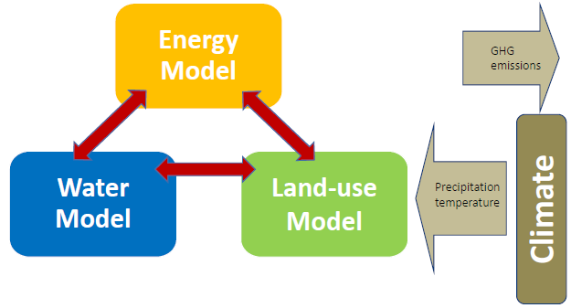
Identifying and quantifying interlinkages among sectors
Identifying robust relationships (i.e., impacts/relationships that are true for a wide range of conditions/assumptions)
Identifying key risks (impacts/relationships that are true under certain circumstances)
Exploring technology and policy alternatives to
Mitigate unwanted outcomes (minimize impact of trade-offs)
Realize co-benefits (maximize synergies)
CLEWs

Slide 10
Implementing a CLEWS assessment
Systems profiling
Current state and historical trends
Pre-nexus assessment
Interlinkages among sectors
Model development
Model development—sector models to fully integrated models
Main stress points
Sectoral policies, plans, strategies
Pressure points within and among sectors
Focus on the nexus analysis
Data availability
Model calibration
Soft-linking of model inputs and/or outputs in the case of sector models
Scenario design and development

Slide 11
Implementing a CLEWS assessment, cont’d
Analysis
Analysis and interpretation of results
Inform policymaking
Report on the quantification of the impacts of sectoral interactions
Revise inputs/assumptions
Conduct additional model runs (iterations)
Suggestion of strategies and pathways towards sustainability

Slide 12
Examples of modelling tools
 | Energy | Water | Land use
Model | MESSAGE LEAP OSeMOSYS | WEAP MIKE BASIN Cli Run | AEZ LEAM
“Scale of Operation“ | From small island systems to large country analysis | Local water systems based on geographical data | Small scale to country analysis (flexible grid cell sizes)
Inputs | Demand (current/future, load curves) Existing and planned power plants Imports and exports, and resource availability Greenhouse gas emission factors | Climatic data Land cover data Soil data and water availability Water consumption Desalination and hydropower | Climatic data (plus projections) Land cover data Soil data
Outputs and results | Future optimal energy mix under different conditions, Future emissions Costs | Water availability under different scenarios (climate change and/or demand change) for all points in a modelled system | Crop map (most suitable by area) Crop calendar Future water demand Fertilizer demand
Notes:
Note: Only present the first row of the table. The rest is for reference.
A range of models can be used to conduct the analysis. Even though the names are not important, a few examples are shown here.
In energy system models, we can have cost-optimization tools. These include: the Long-range Energy Alternatives Planning tool (LEAP) from the Stockholm Environment Institute; the Open Source Energy Modelling System (OSeMOSYS) from the Royal Institute of Technology, Stockholm; and the Model for Energy Supply Strategy Alternatives and their General Environmental Impact (MESSAGE) from the International Atomic Energy Agency.
MIKE BASIN (a multipurpose, map-based decision support tool for integrated water resources analysis, planning and management of river basins) and the Water Evaluation and Planning System (WEAP) from the Stockholm Environment Institute are water system management tools (water balance tools), which aim to fulfill certain demands for water. Cli Run can be described as an optimization tool that can, for instance, help in the assessment of hydropower generation.
AEZ refers to agro-ecological zoning models developed by the International Institute for Applied Systems Analysis.
LEAM is the Landuse Evolution and Impact Assessment Model developed by the University of Illinois at Urbana-Champaign. It is an accounting tool intended to enable users to capture stochastic influences and view the reported probable consequences of intended events in a scenario-based format that is comprehensible by local experts, decision makers and stakeholders.

Slide 13

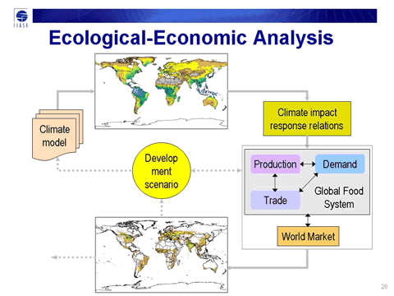


CLEWS
Integrated assessment
Energy
quantifying the FEW-NEXUS
EMISSIONS EMISSIONS
Water
Land - Food
AEZ
Climate
Emissions

Slide 14
Water management modelling
Water for energy
Water for nature
Water for agriculture
Water quantity
Water quality
Water for navigation
Seasonality of flow
Domestic water
Regulation
Water for recreation
Water for industry
Notes:
Water management tools essentially aim to achieve a water balance in the system. Taking into account precipitation patterns, and surface and groundwater resources, we are able to estimate water availability and addition into the system at each given (spatial) point. Different processes in the economy then consume (e.g., agriculture, electricity generation or industrial processes) or require (e.g., navigation) water. These tools help prioritize the use of water.

Slide 15
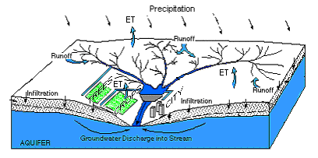
Water management model: critical questions
How to allocate water to competing uses?
How to best operate water infrastructure (e.g., dams, diversion works)?
How water allocation, operation rules and constraints should adjust to new management directives?
How to jointly manage water for irrigation and energy requirements?
Notes:
Water is not an infinite source. Arid and semi-arid regions require careful planning by authorities to manage their water resources, while even countries with high levels of precipitation can suffer from periods of unexpected droughts. In a changing climate, the vulnerability of infrastructure (e.g., hydropower plants, industrial plants) or important economic processes (e.g., agriculture, residential water demand) to lack of water has to be assessed in both cases. Water management models assist in defining optimal water resource allocation across various processes for a range of climate scenarios.

Slide 16
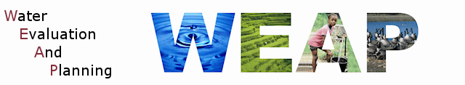
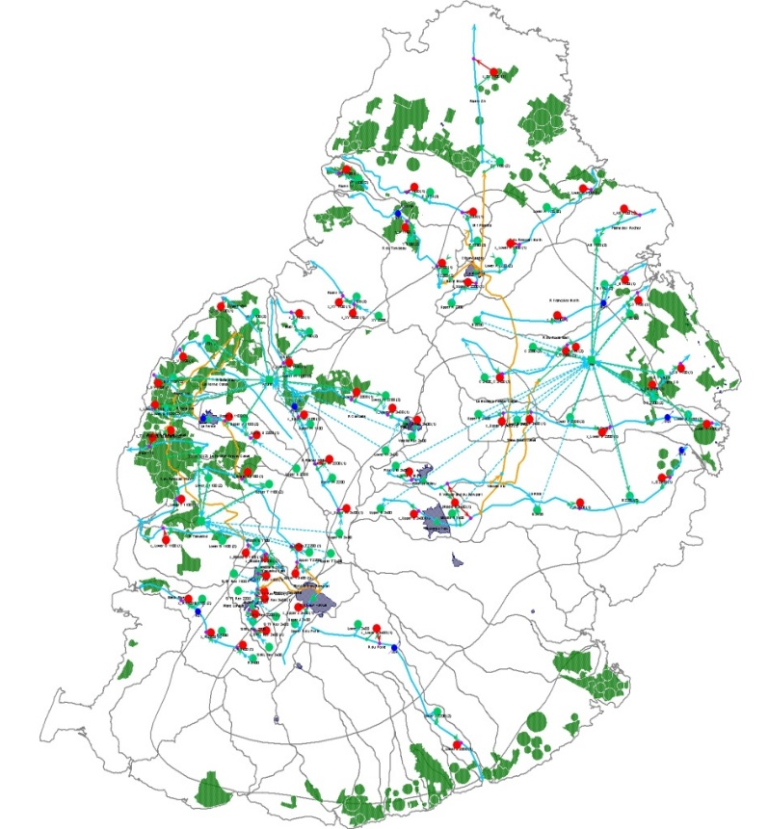
The water model
Required model inputs include:
Definition of all catchment areas
Real climatic data: rainfall, minimum and maximum temperature, humidity...
All main rivers and reservoirs plus stream flow data and reservoir levels
Modelling of existing canals/distribution systems
Using GIS: land cover classes to calculate evapotranspiration
Water demand data (urban and agricultural) according to national statistics and population density
Notes:
Surface water bodies and groundwater are taken into account. Spatially based modelling allows for water demand at each geographical point to be defined. Similarly, water resources and precipitation at each point are defined. By having water outputs (i.e., water consumed, losses through evapotranspiration, etc.) and water inputs (i.e., via precipitation, and surface and groundwater bodies) modelled in each point, the model can strike a mass balance for all relevant processes.
GIS indicates geographical information systems
Temperature and humidity affect evapotranspiration, which in turn affects irrigated water demand. Higher temperatures and low humidity levels result in increased losses through evapotranspiration, which means that crops require higher water inputs.
Flow data and reservoir levels are especially important for determining at what capacity hydropower plants can operate.
Canals and distribution systems determine accessibility of each point to water.
The type of soil affects how and at what speed water can move through the ground.

Slide 17
The energy model
Used to represent physical flows, capacities and energy balances through an energy system
Accounting models: Can be used to assess the impacts of predetermined pathways for development, e.g., LEAP, MAED
Simulation models: Represent decisions of actors within the system
Potential for replacing existing technologies with low-carbon, more efficient or cost effective alternatives
Optimization models: Can be used to maximize benefits; or minimize costs, e.g. OSeMOSYS, MESSAGE, MARKAL
Technology learning rates, resource availability, technical limitations, vintage of infrastructures, penetration rates, environmental criteria, costs, etc. directly affect the optimal system design.
Notes:
Make a connection with the energy systems model module, noting that it covers these issues in more detail.
Energy system models can generally be categorized into bottom-up techno-economic models and top-down macroeconomic models. The former employ a high degree of detail in terms of technologies but cannot provide any insights on net impacts across the economy. The latter look into aggregated sector-specific energy demand and supply and assess effects on the entire economy but are not suitable for analysing potential technology deployment, due to insufficient detail. This slide only refers to bottom-up models, giving the three subcategories of simulation, optimization and accounting.

Slide 18
Energy system model: critical questions
What are the investment requirements in generation and network infrastructure and their timing to meet electricity demand and when?
How can energy security be enhanced?
What is the cost of expanding modern energy services?
What technologies and fuels grant the lowest cost, most reliable energy mix?
What is the scope for producing biofuels and generating electricity form large-scale solar photovoltaic parks or wind farms?
What are the water requirements—e.g., water for cooling, hydropower, irrigation of biofuels?
What pollutants are emitted and in what quantities?
Notes:
Note: If the workshop includes the module on the Energy Systems Dynamic Model, this slide can be skipped.
Investments in energy infrastructure have long lifetimes, generally lasting more than a couple of decades. Due to this, investment decisions need to be made taking into consideration the techno-economic environment in the future, so as to minimize financial risk. >>This can be a starting sentence for the first two bullet points.
Energy acts as a driver of economic development, especially in developing countries, but also leads to impacts on land-use, water-use and, depending on the technologies used, can release pollutants in the atmosphere, on land or in water bodies. >>This can be a starting sentence for the last three bullet points.

Slide 19
The land-use model
AEZ–Agro-ecological Zoning
Inputs
Climate data
Detailed soil map and data from soil profiles
Slopes and marginal land
GIS data for land cover
Irrigated areas
Output
Grid map showing optimal crops, and potential water use and yield, plus a crop calendar
Notes:
The GAEZ database contains information for a large number of climate scenarios, including the yield of different crops, water demand, suitability of land for each crop, etc. The database provides the agronomic backbone for various applications including the quantification of land productivity. Results are commonly aggregated for current major land use/cover patterns and by administrative units, land protection status, or broad classes reflecting infrastructure availability and market access conditions.
Land and water resources, including soil resources, terrain resources, land cover, protected areas and selected socioeconomic and demographic data
Agro-climatic resources, including a variety of climatic indicators
Suitability and potential yields for up to 280 crops/land utilization types under alternative input and management levels for historical, current and future climate conditions
Downscaled actual yields and production of main crop commodities
Yield and production gaps, in terms of ratios and differences between actual yield and production and potentials for main crops

Slide 20
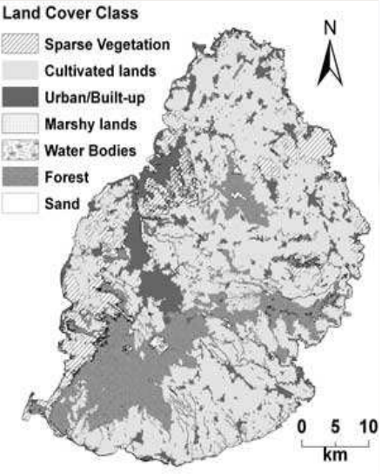
Agro-ecological modelling
Geospatially based analysis of agricultural output to assess:
What is the potential yield of a range of crops in each region?
What are the water requirements for each crop in each modelled sector?
How do different climate scenarios affect crop yield?
Quantification of input requirements to achieve a certain level of yield.
Notes:
Agriculture covers one of humanity’s key necessities: access to food. At the same time, crops can be grown for energy purposes, for instance, for use as biofuels in transport.
A greater agricultural yield could potentially improve the trade balance of a country, be it for food or for energy. Intensive agricultural practices can stress natural resources, however.
Land may need to be converted to agricultural purposes, additional water may be needed for irrigation, energy may be required for water pumping and operation of machinery, while fertilizers and pesticides may be applied to improve yield.
Agricultural yield can be affected by factors outside of our control (e.g., precipitation, temperature, extreme weather events). Since agriculture is such an important aspect of an economy, it has to be carefully managed. >> Make a connection between this narrative and the questions above.

Slide 21
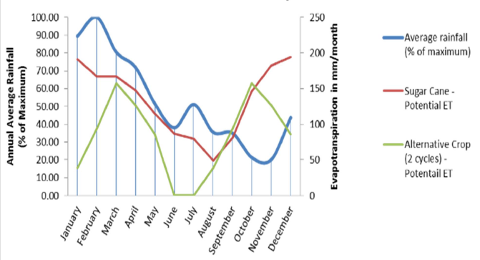
Agro-ecological modelling
Example: rainfall pattern and water demand by crop
Notes:
Seasonal precipitation patterns do not follow seasonal water demand. This adds stress to existing water resources and creates a need for irrigated water, which in turn requires energy. Instead of relying on just sugarcane in this example, carrying out crop rotation (green line) has the potential to decrease evapotranspiration, thus reducing irrigated water demand.

Slide 22
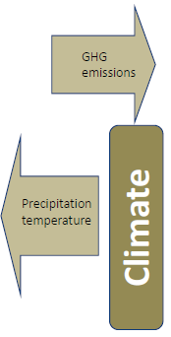
Climate representation
Climate is defined by the major assumptions in land-use, water management and energy systems models.
Apparent need for consistency—e.g., greenhouse gas emissions limits versus long-term estimates for air temperature and precipitation
Accounting of greenhouse gas emissions
Temperature and precipitation affecting agricultural production
Solar insolation affecting photovoltaic and concentrated solar power generation
Precipitation affecting hydropower and water irrigation demand, quantifying seasonality of availability
Interlinkages between effects across sectors are highlighted
Notes:
In CLEWS work, no actual climate modelling takes place, but the different components of the methodology (land modelling, water modelling and energy modelling) get their inputs from existing climate models. These provide information such as temperature, precipitation patterns, etc., which are required in the aforementioned models.
We need to be consistent in the scenarios being used. For instance, if we are assuming a scenario where temperature increases by 2 degrees C, then emissions from our energy system model need to be consistent. The same applies to precipitation patterns in land and water models.
An energy system model can act as an accounting tool for emissions or optimize based on an emissions limit. Thus, emissions can be an input or an output of the exercise.

Slide 23
Optimization in the integrated CLEWs tool
Representation of the physical system (i.e., “bottom up”)
Technologies are described by their technical and economic characteristics
Full value chains (e.g., well-to-wheel or field-to-fork)
Web of interconnected value chains
Meets consumer demands
Balance of supply and demand
Clears each commodity market in every value chain
Identifies cost-effective strategies subject to constraints
Configures system to find deployment and utilization patterns that meet demands at lowest possible cost

Slide 24
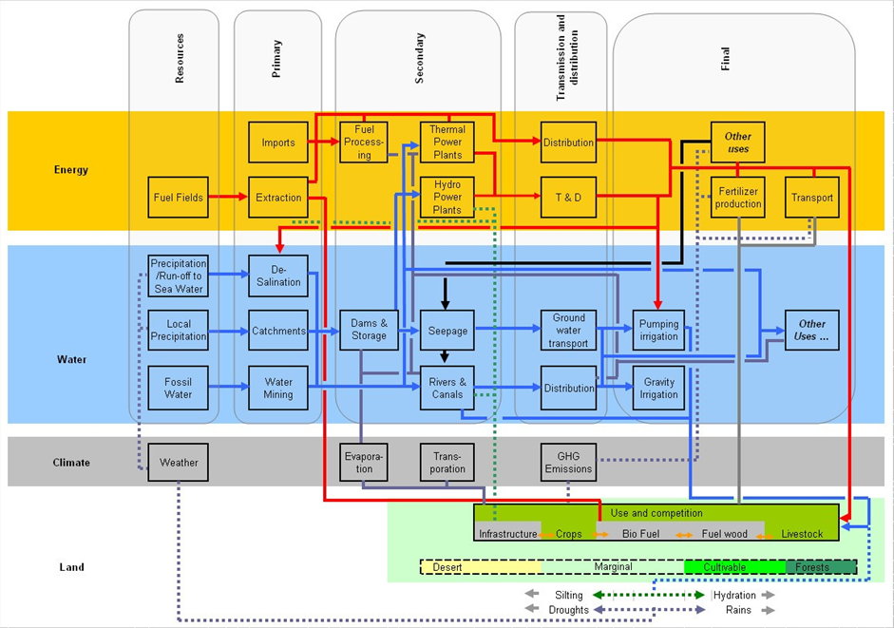
CLEWS
Notes:
The figure shows a generic aggregate reference CLEWS system. Technologies and energy/water flows are represented throughout the system to show the key interconnections between processes and resources. The figure illustrates the interactions among different dimensions of CLEWS.
Climate change aspects can act as inputs (e.g., precipitation, temperature) influencing key processes (e.g., hydropower generation, demand for irrigation) or as outputs (e.g., greenhouse gas emissions).

Slide 25
Integrated CLEWS optimization tool
Inputs
Demand curves
Technology performance
Technology cost (capital, operation and management)
Commodity cost (extraction cost, import cost)
Cost of capital
Emissions intensity
Constraints (environmental, regulatory, policy, market, etc. )
Outputs
Investment (physical units and cost)
Total production capacity
Operating costs
Asset utilization
Output (physical units)
Fuel expenditures
Emissions
Shadow prices

Slide 26
Concluding remarks
A flexible modelling tool to quantitatively assess the food-energy-water nexus in the context of climate change
Integrated entry point to inform sustainable development policies, including related to the 2030 Agenda and Paris Agreement
Retains sector relevance while providing an integrated assessment
Can contribute to institutional coordination for integrated policy formulation

